Slide 1
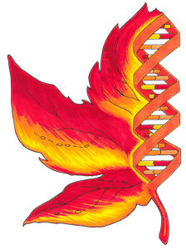
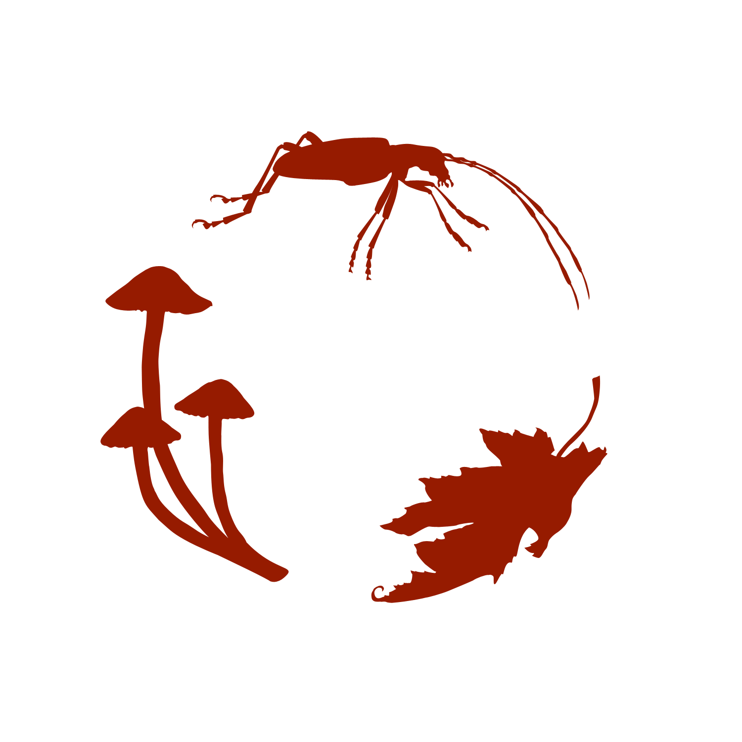


Occurrence search with Practical exercises
Jérémy Goimard – TDWG 2017 – Ottawa, Canada
Notes:
Canadensys est un projet pan-canadien qui cherche à publier l’ensemble des données d’occurrence de la biodiversité provenant des collections canadiennes et d’observations
<number>

Slide 2
Main objectives:
Show you why ALA Framework is so cool!
Have some fun, it was a big day, today!
What is biocache-hub?
Connections to others ALA modules.
How to see data?
- Explore occurrences (Canadensys portal)
- With Extra-Layers (Spain portal)
- Explore your area (Sweden portal)
- Explore your region (NBN portal)
- Let’s try with your sample datasets (TDWG Workshop portal)
Steps

Slide 3
Way to :
- see/present occurrences
- check interest of a research
- get an initial look at your idea
- etc ...
Linked with ALA Modules:
- biocache-backend
- biocache-webservice
Biocache-hub

Slide 4
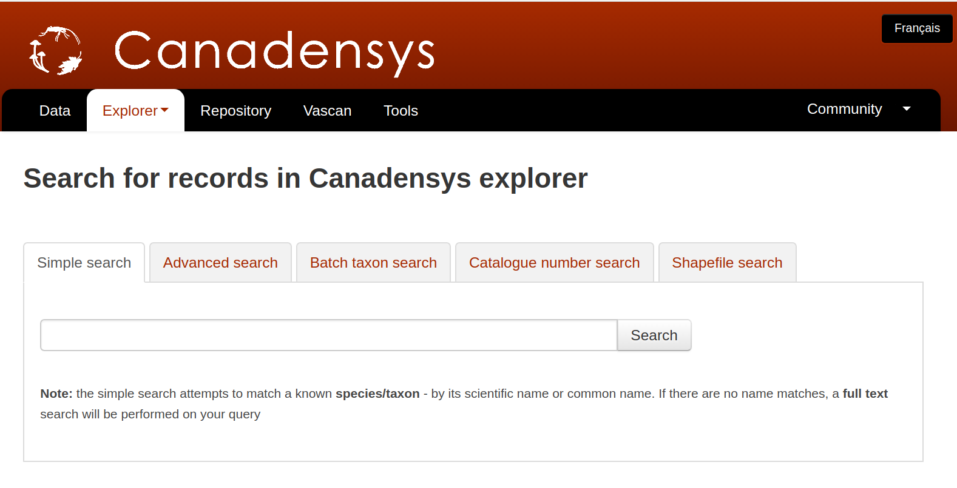
http://explorer.canadensys.net/
Explore occurences (Canadensys portal)

Slide 5
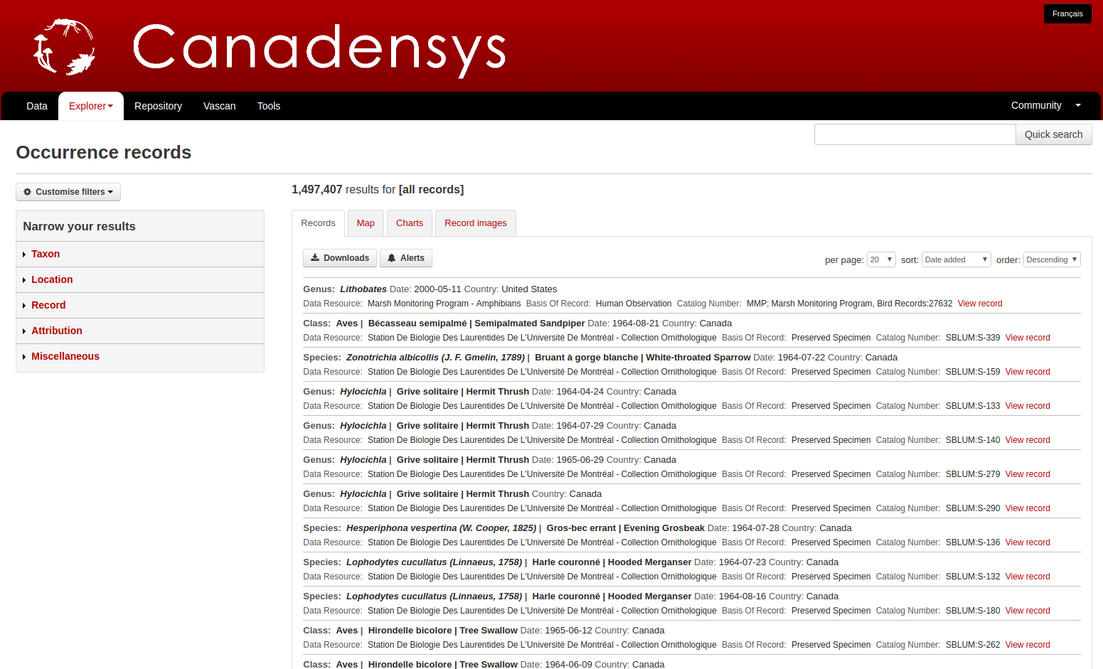
1
2
Explore occurences (Canadensys portal)

Slide 6
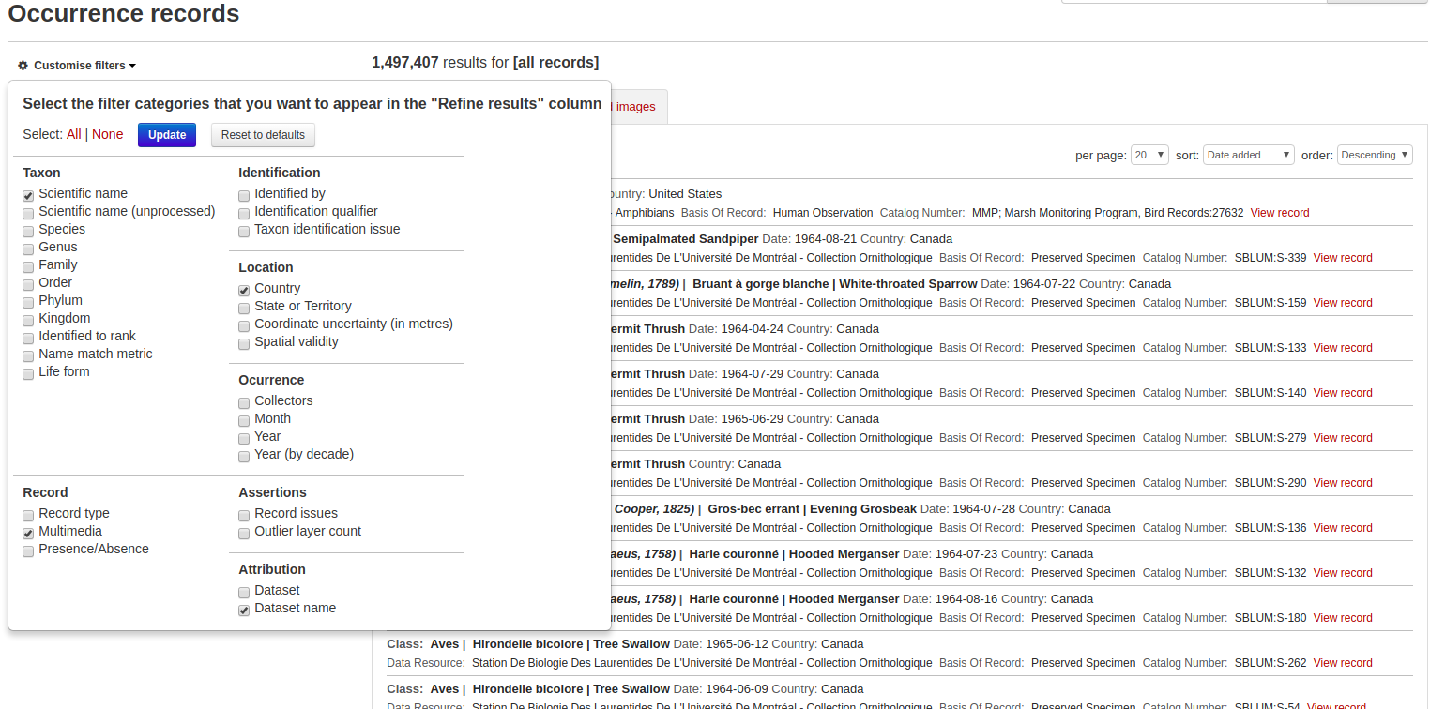
1
Explore occurences (Canadensys portal)

Slide 7
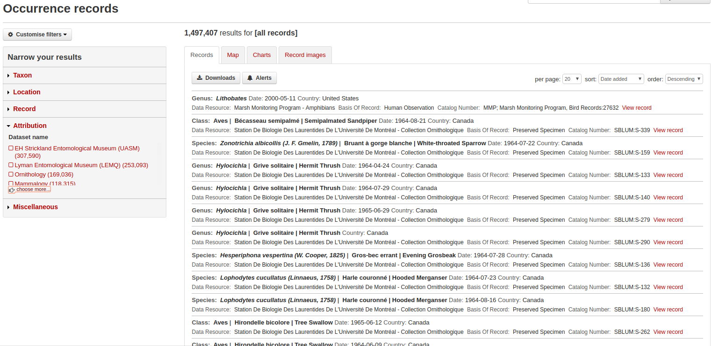
2
Explore occurences (Canadensys portal)

Slide 8
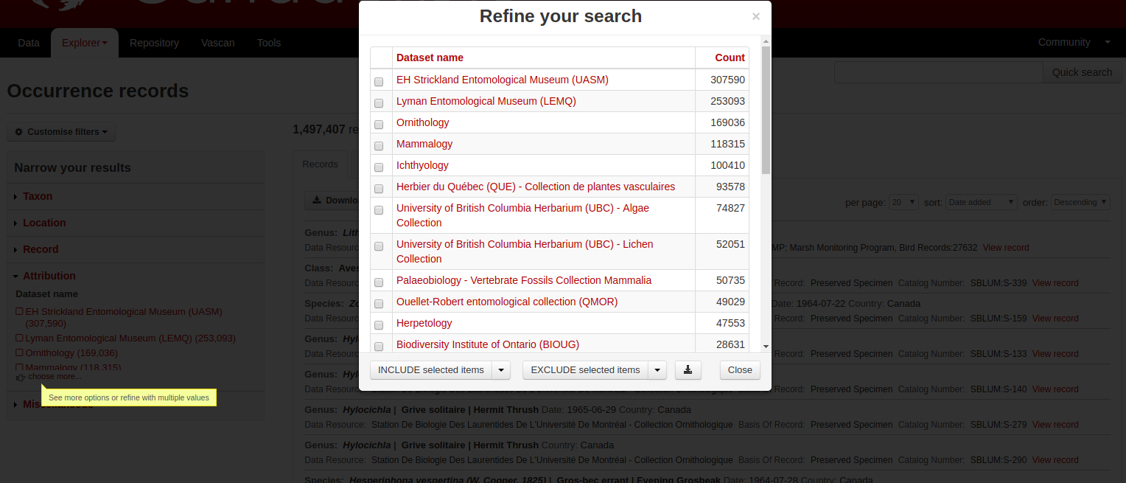
2
Explore occurences (Canadensys portal)

Slide 9
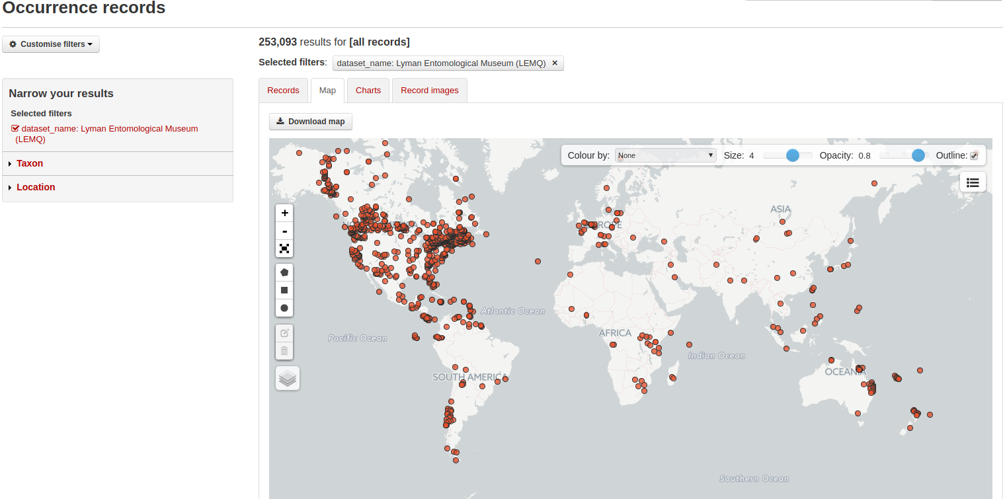
Explore occurences (Canadensys portal)

Slide 10
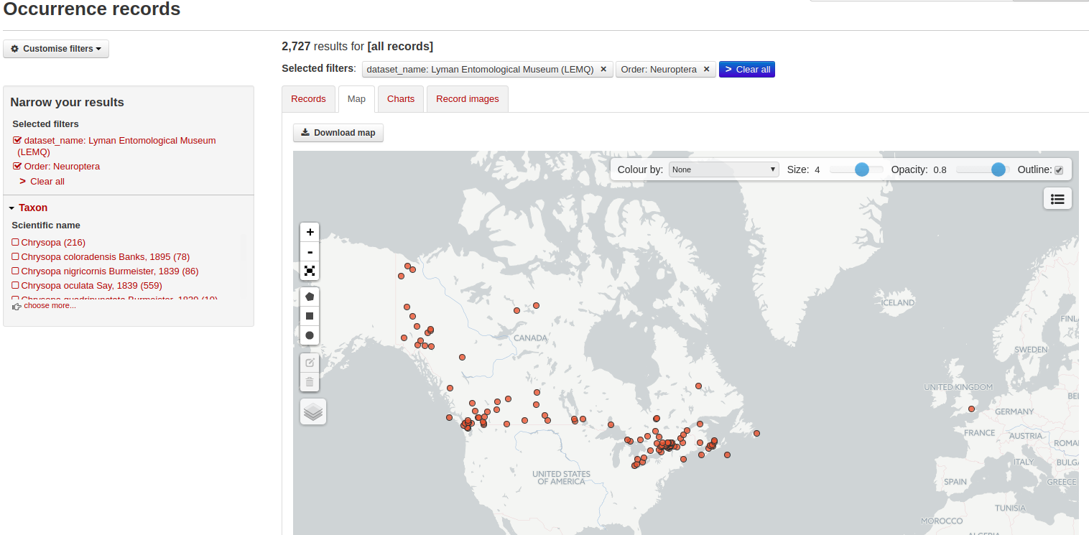
Explore occurences (Canadensys portal)

Slide 11
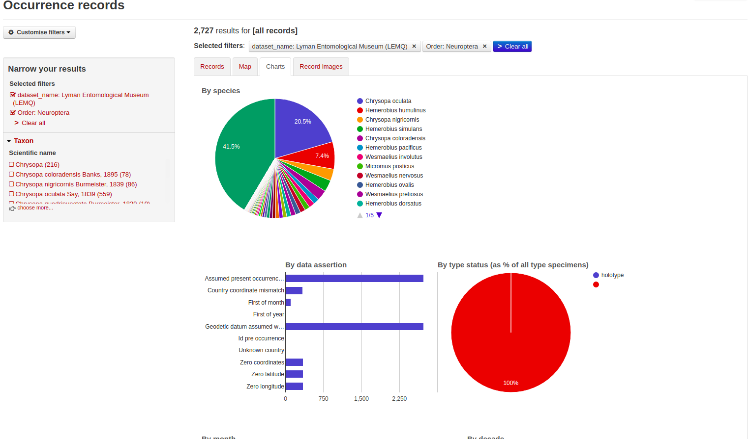
Explore occurences (Canadensys portal)

Slide 12
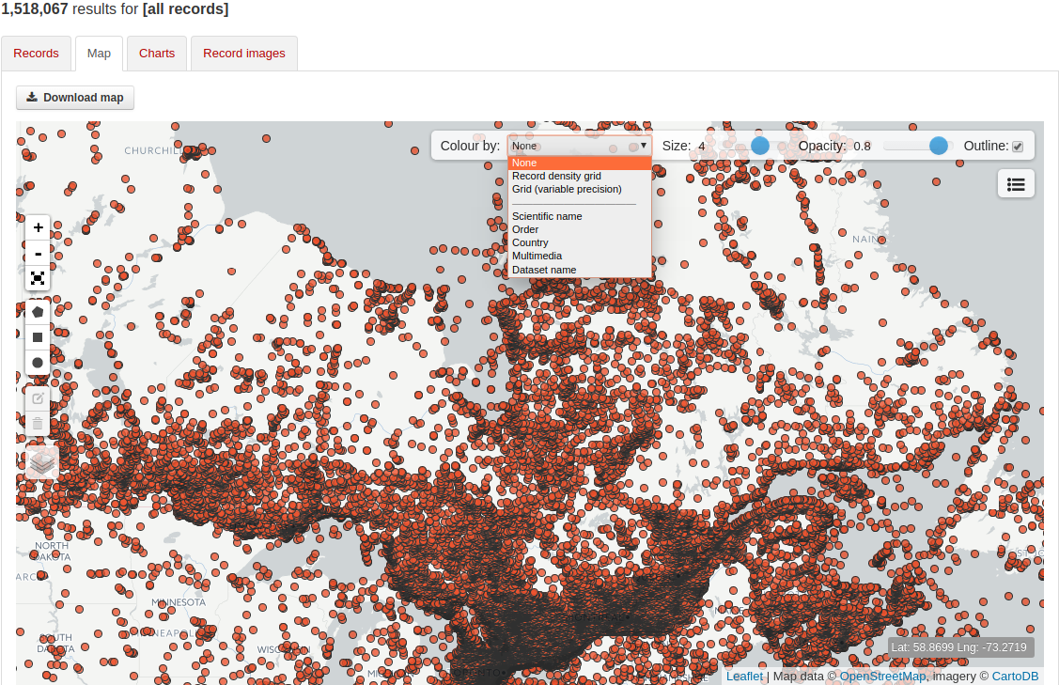
Explore occurences (Canadensys portal)

Slide 13
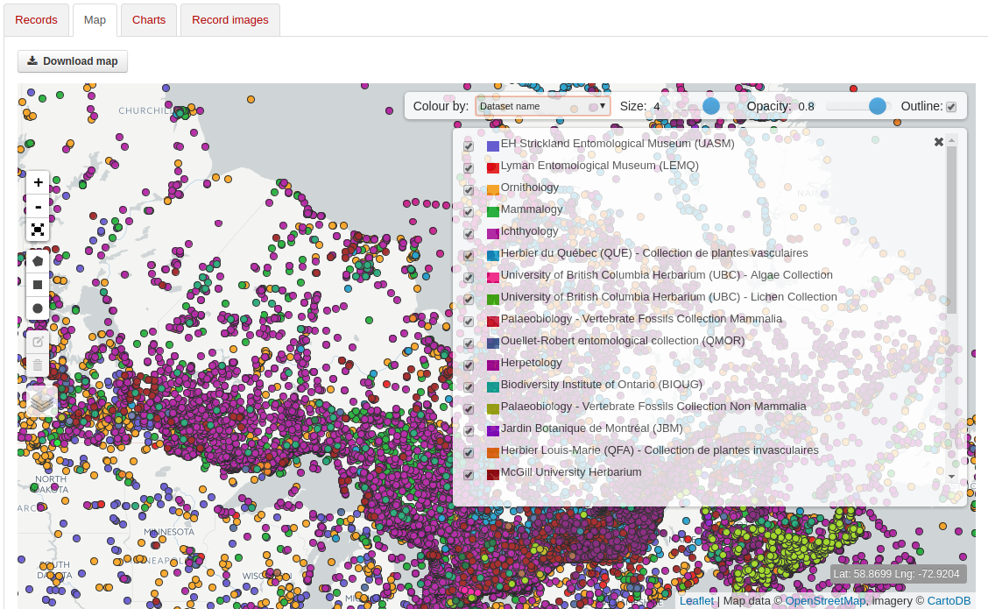
Explore occurences (Canadensys portal)

Slide 14
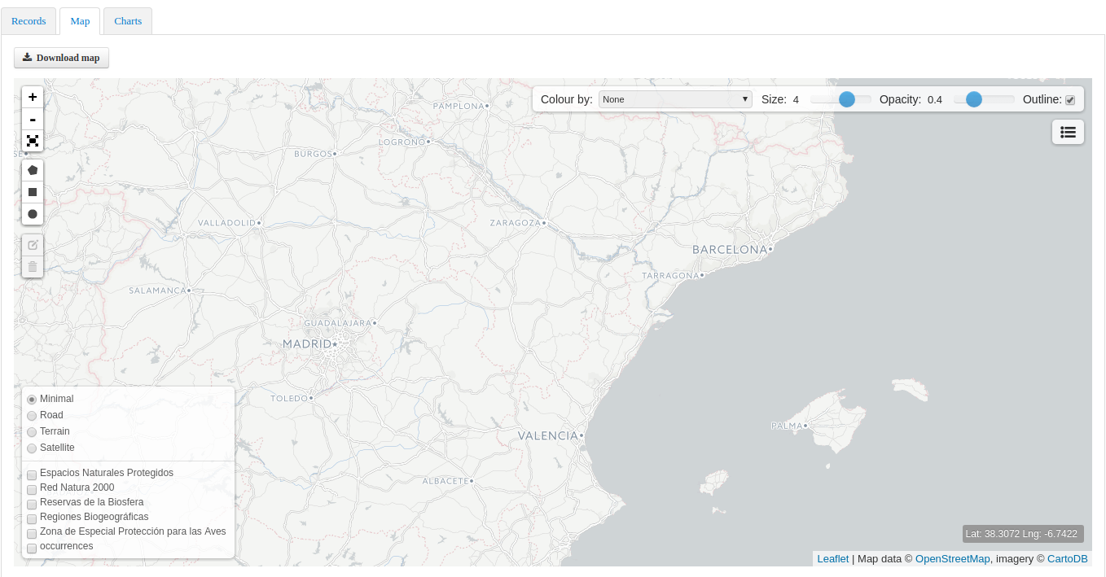
1
http://datos.gbif.es/generic-hub/occurrences/
Explore occurences – Extra Layers (Spain portal)

Slide 15
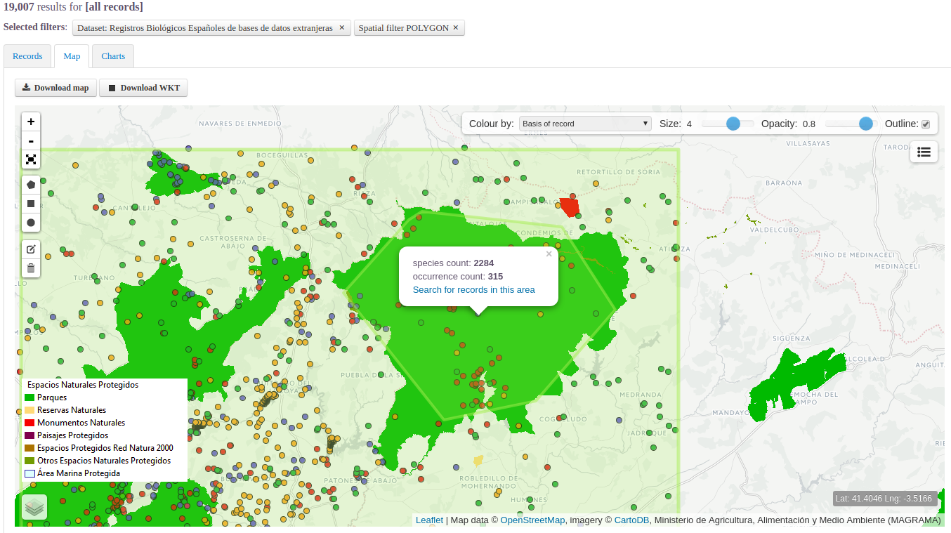
1
Explore occurences – Extra Layers (Spain portal)

Slide 16
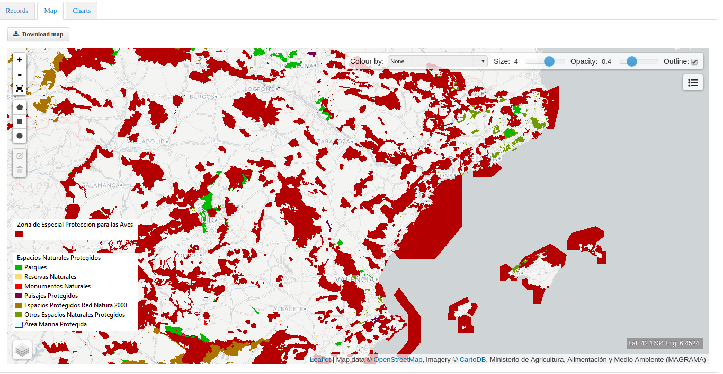
1
Explore occurences – Extra Layers (Spain portal)

Slide 17
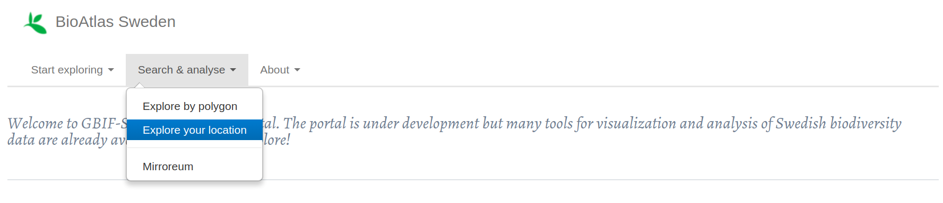
https://bioatlas.se/
Explore your area (Sweden portal)

Slide 18
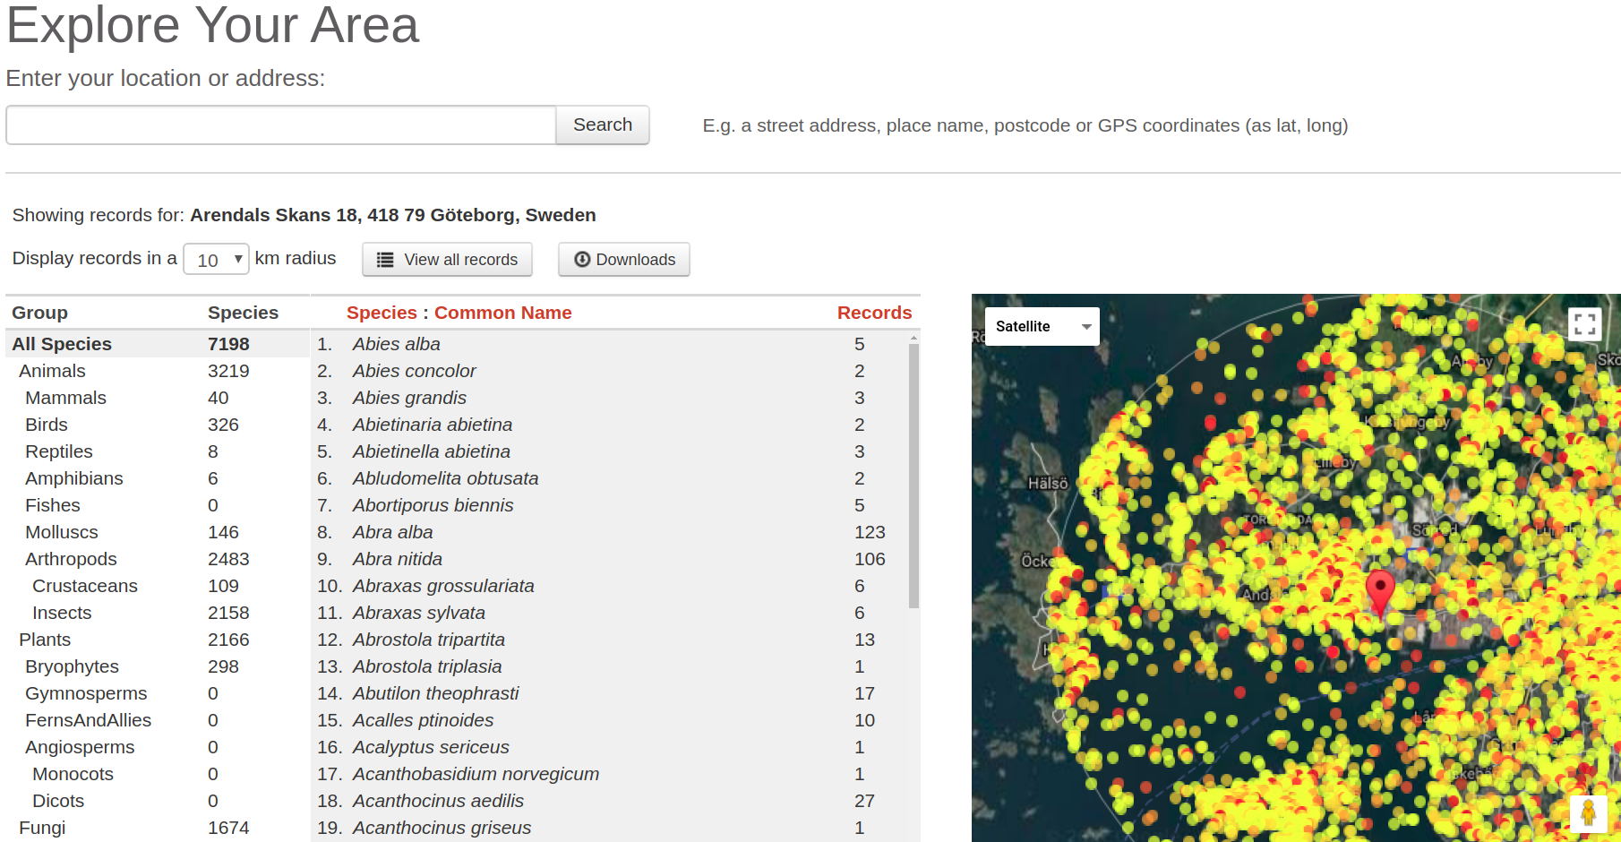
1
2
5
4
Explore your area (Sweden portal)

Slide 19
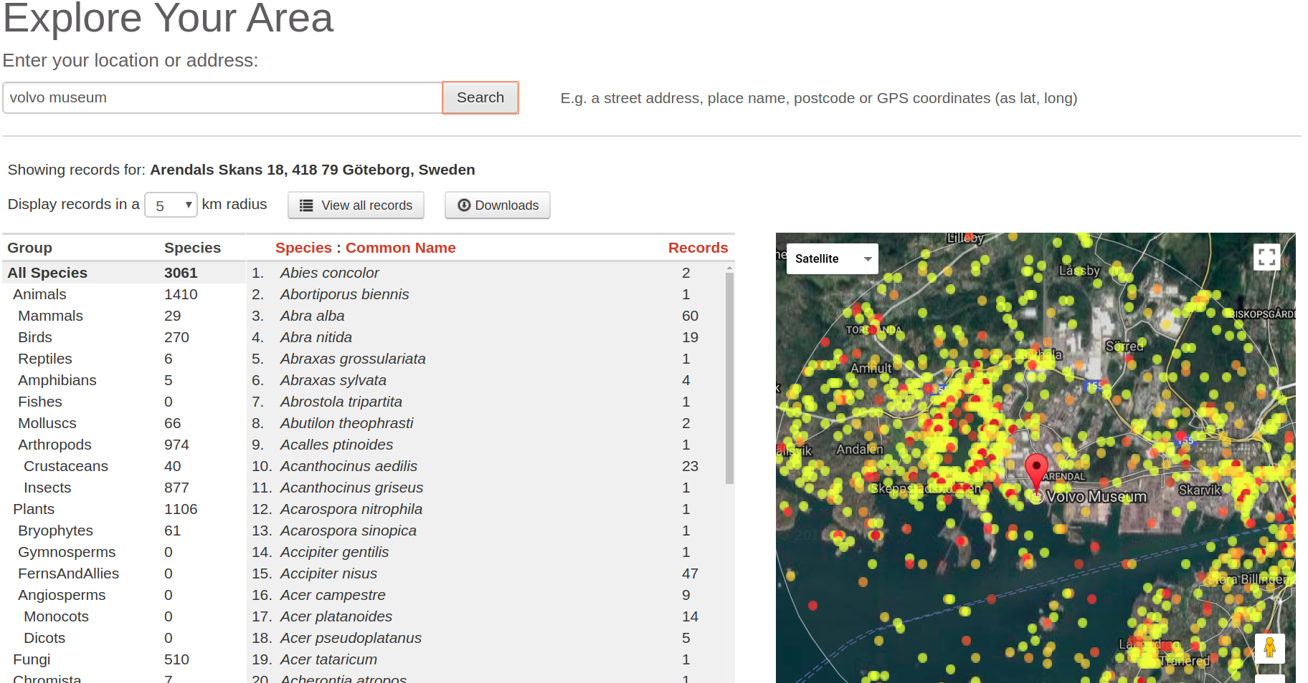
Explore your area (Sweden portal)

Slide 20
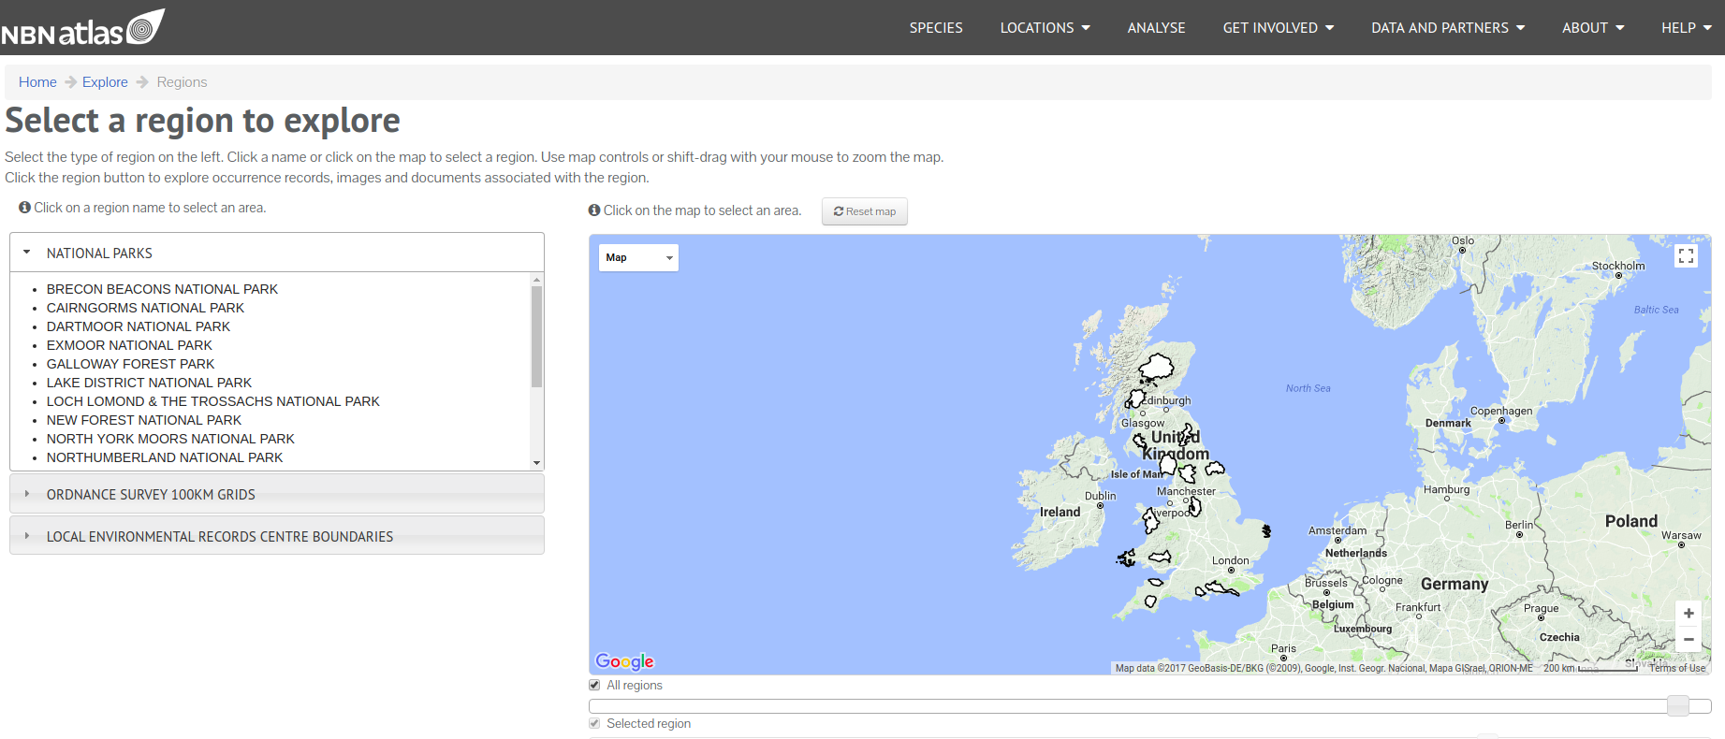
1
2
3
https://regions.nbnatlas.org/
Explorer your region (NBN portal)

Slide 21
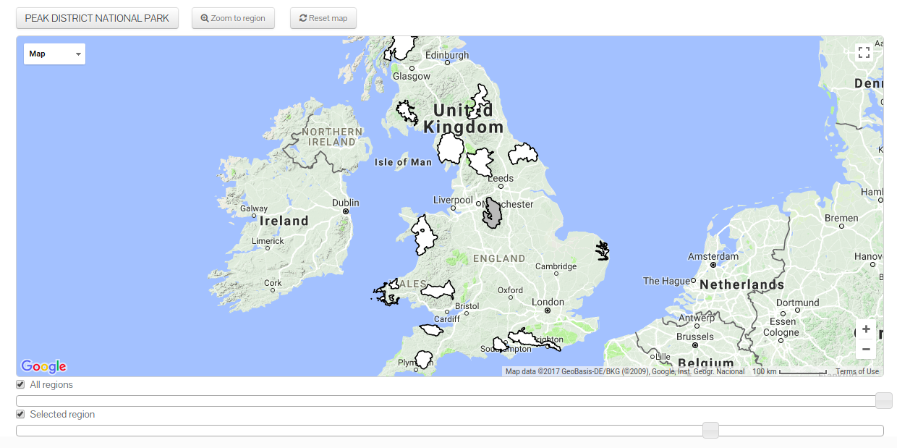
4
2
3
1
Explorer your region (NBN portal)

Slide 22
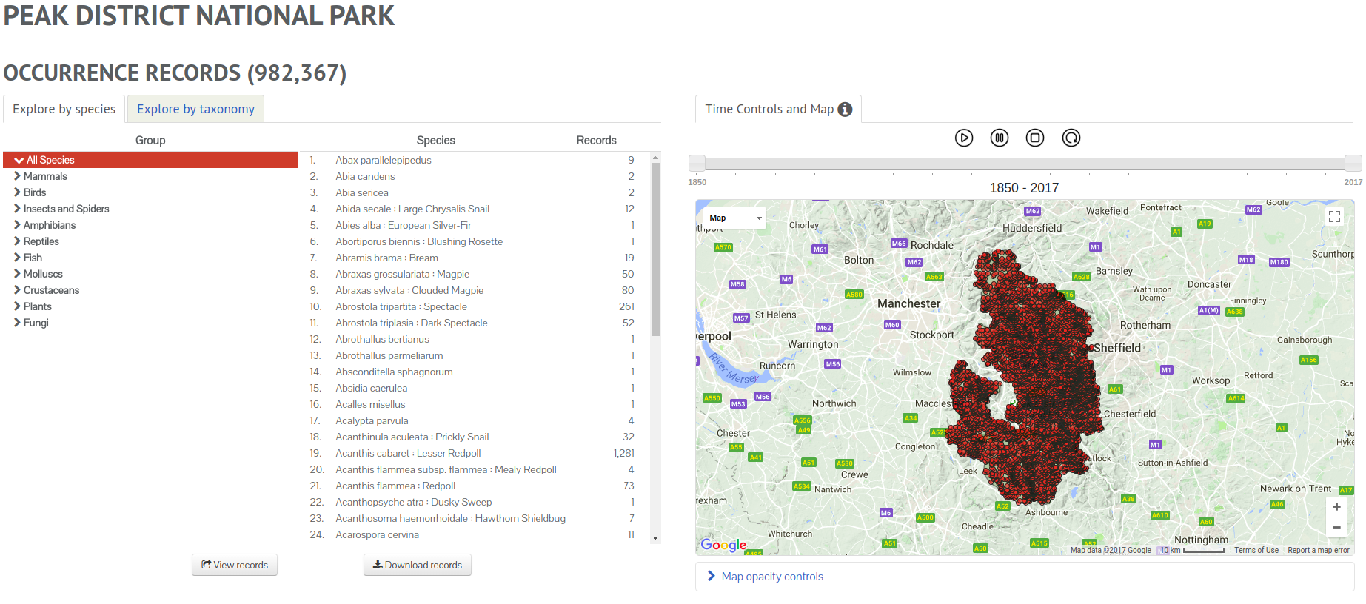
1
2
3
4
Explorer your region (NBN portal)

Slide 23
Exercices on NBN Portal :
(https://records.nbnatlas.org/occurrences/)
1. Find all occurrences:
1.a. for ‘River Macrophytes Database’ and show them as dots on the map
1.b. for :
Data resource: Fungal Records Database of Britain and Ireland
Year: "2005"
Scientific name: "Gymnopus dryophilus"
Let’s try with exercices (TDWG Workshop portal)

Slide 24
Exercices on NBN Portal :
(https://nbnatlas.org/)
2. What is the most repesented family? And genus for 2009?
3. How many occurrences on ‘Islay Natural History Trust’?
4. How many species inside a circle of 10 km around ‘isle of man airport’ ?
Do you have one?
Let’s try with exercices (TDWG Workshop portal)

Slide 25



GBIF Sweden Portal
GBIF Spain Portal
NBN Portal
Resources and acknowledgments

Slide 26
Thank you for
your time and attention
See you in the next workshop!
Canadensys

